Slide 1

Stop Log Dam By-Pass
Setting their sights on healthy fish habitat in Armstrong Creek in Markdale
July 4,2019

Slide 2
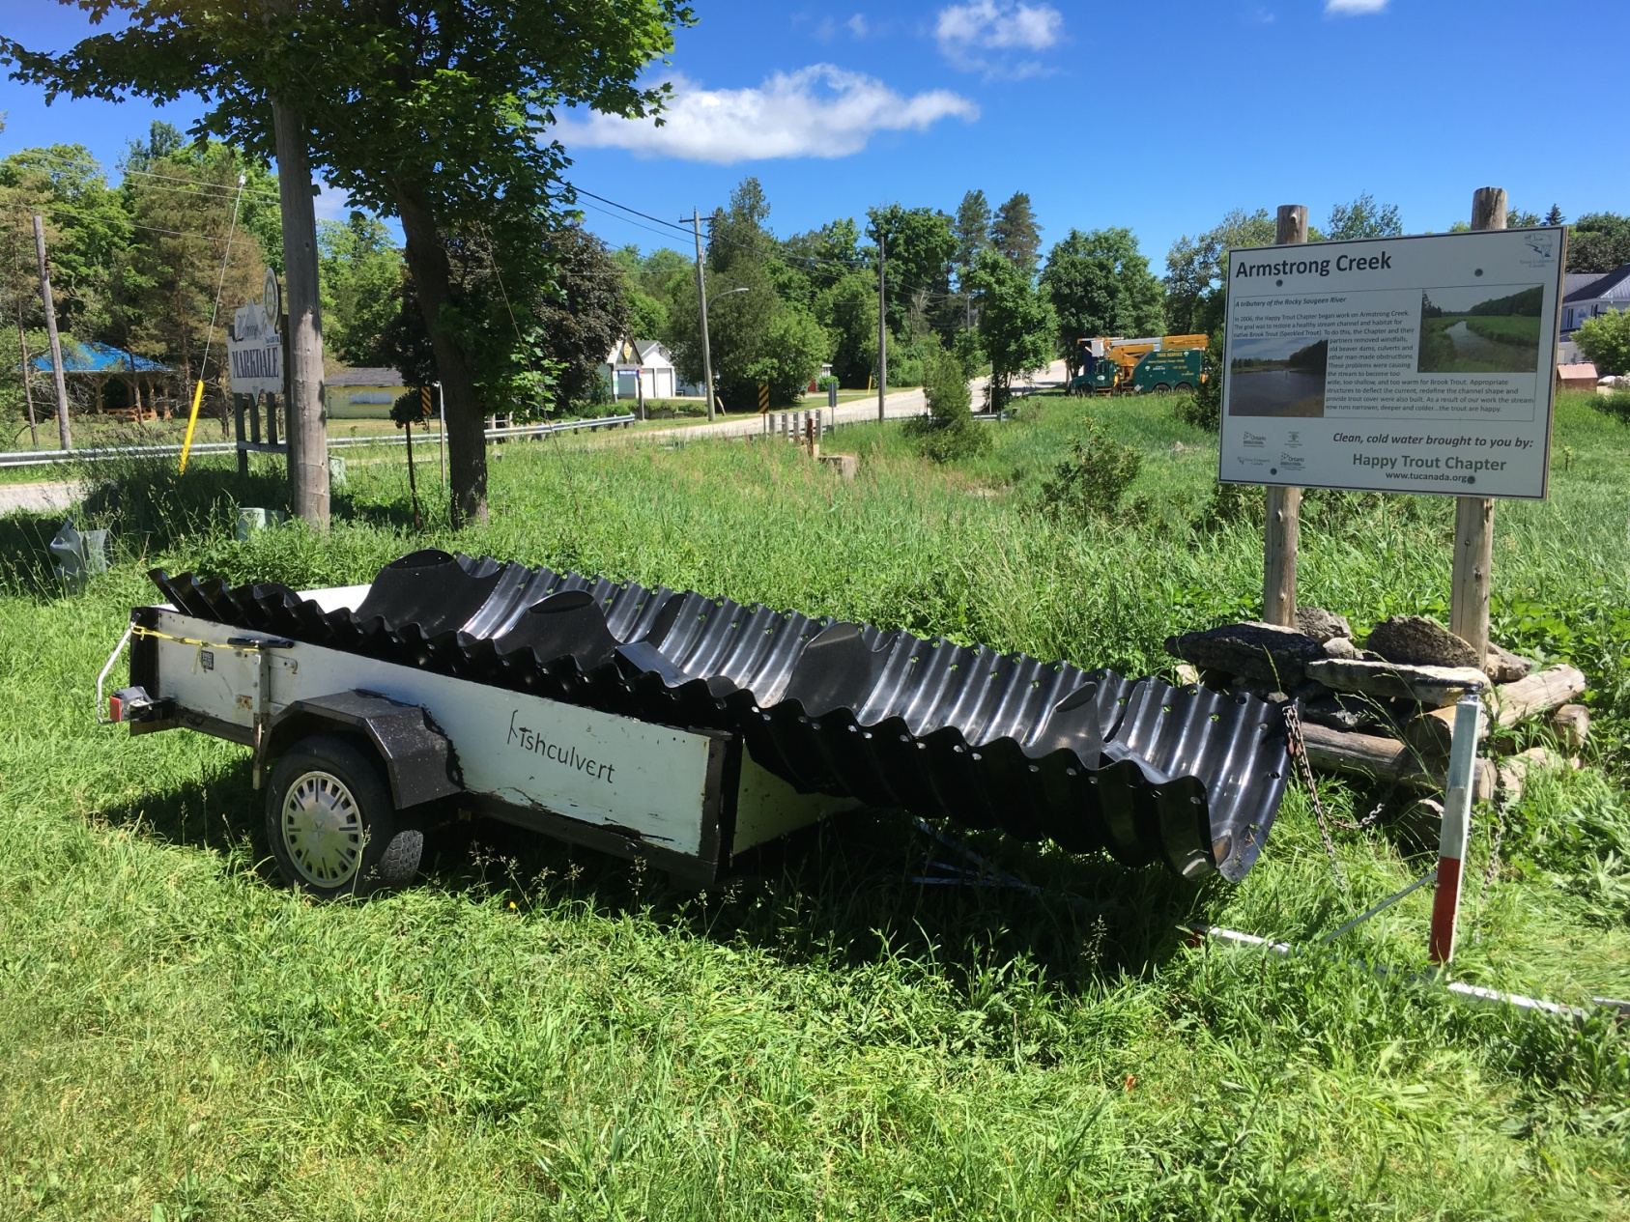
2019

Slide 3
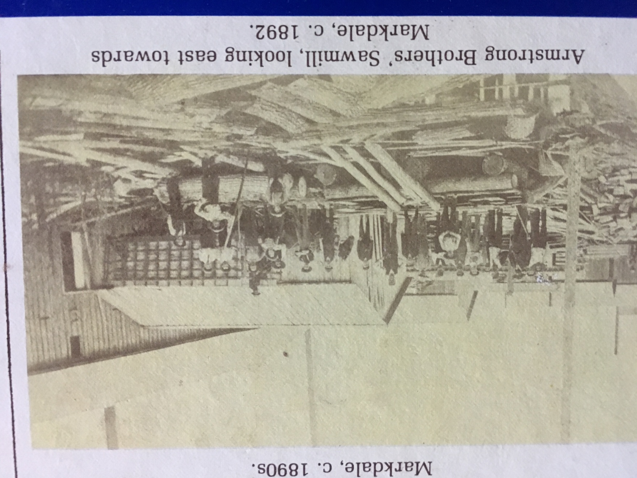
1892

Slide 4
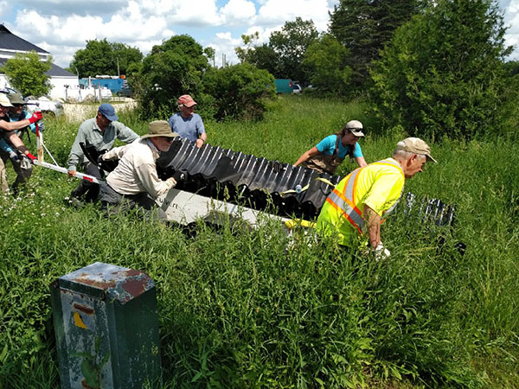
Rolling Down the Bank
Notes:
David Penny wearing the yellow construction vest, is the owner of Fish Culvert. Biologist Alex Meeker in the blue t-shirt, David and members of Happy Trout work hard to push the heavy 900 lb fish culvert down to the creek. Not shown is Mayor Paul McQueen who stopped by to help out.
BY SOUTHGREY.CA STAFF — Happy Trout, a chapter of Trout Unlimited Canada, an environmental not-for-profit organization were working in Armstrong Creek which is a tributary of the Rocky Saugeen River. They were undertaking to restore and protect the fish habitat.
Trout Unlimited Canada Provincial Biologist Alex Meeker said, "Armstrong Creek spits out just down stream of where the fish culvert was being installed. It is designated as a cold water creek, which makes it crucial habitat for brook trout which are a cold water species. They don’t like temperatures of more than 20 degrees Celsius, they expire at anything above 25 degrees"
"What we are trying to do here, is because brook trout spawn closer to the upstream regions of this river once they go down, they haven’t been able to come back up again. The ramp is designed to help facilitate their migration back upstream to their spawning grounds. Before now, the trout would have reduced access to ideal spawning grounds," said Meeker.

Slide 5
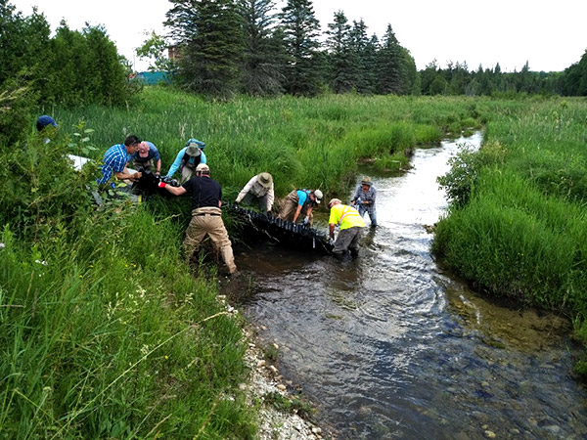
The Launch
Notes:
Brook trout require cold water upflowings from ground water sources which there are many through this section of Armstrong Creek. The fish culvert is the only one that will be installed in the local area. In the photo, left to right front Mayor Paul McQueen, Brad Mulligan, Dave Penny, back of trailer, Bob James, Arunas Liskauskas, Jack Imhof, Alex Meeker and Jo Harris in the creek.
Meeker continued, "When they lay their eggs in the fall, they tend to place their eggs on ground water upwellings because it gives them the competitive advantage over species such as brown trout. When the water comes in throughout the fall and the winter while there are small eggs still, the water is actually warmer than the rest of the river because it filters through the ground. It helps speed up their incubation period and they can emerge before the Brown Trout, which is a competitor. They are a naturalized species. We are trying to improve the success of Brook Trout spawning by allowing them to reconnect with their spawning grounds which was previously a barrier under the bridge on Grey Road 12."

Slide 6
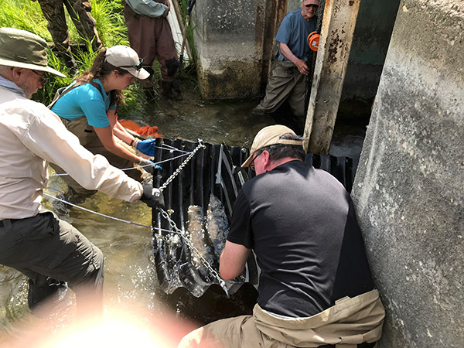
Float Through the Gap
Notes:
Moving the heavy culvert in place became more difficult when it filled with water
"Armstrong Creek is not stocked with trout or any other species to my knowledge", said Meeker. "Brown Trout are a European species and have been here for a long time. Brook Trout are one of our last native salmon species that we have in Ontario. The Atlantic Salmon no longer exists naturally in Ontario. They are an extirpated species. We are trying to make sure the Brook Trout doesn’t go the same way as the Atlantic Salmon. Brook Trout can only jump 30 cm and the barrier under the bridge was too high for the trout to get over. " she added.
The Happy Trout Chapter has been doing work along Armstrong Creek and other tributaries to the Rocky Saugeen since 2005. There are plans for future work on Barrhead Creek which also flows into the Rocky Saugeen River and on the Town Pond Dam which is over 100 years old. Ponds have a larger surface area, so there is a large space for the sun to hit which warms the water very quickly and this is not ideal for cold water species.

Slide 7
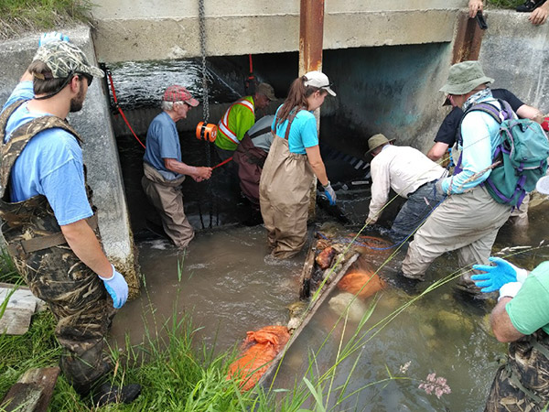
Swamped
Notes:
Getting the water out of the culvert so it can be placed in the proper position. Neil Graham (not in other photos) stands on the left.

Slide 8
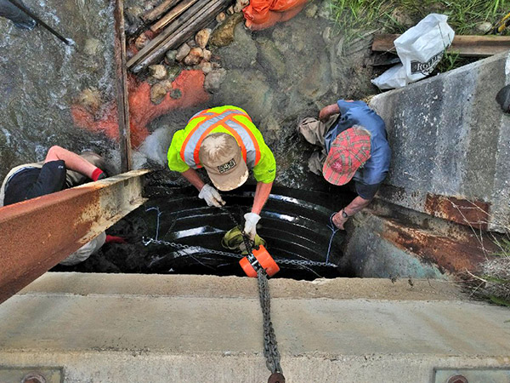
Chain Hoist and Spud Wrench
Notes:
Finally after much effort the culvert was in the right place.
Eventually, the Happy Trout group want to get approvals to remove the dam there to return Armstrong Creek to it’s natural path and natural width. That would then remove another barrier for all the fish to come back up the river to spawn. It would improve water quality and reduce temperatures which is great for cold water species.

Slide 9
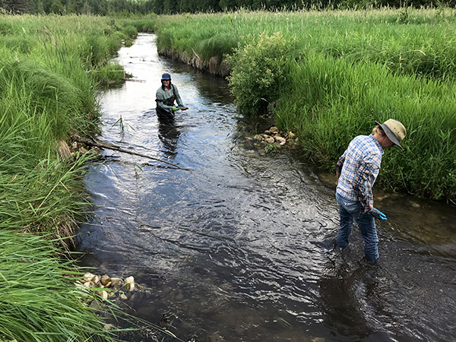
Improving the Upper Pool
Notes:
Don and Jo Harris were working in the creek rolling rocks out of the centre of the channel to the edge of the river. The creek will then become deeper, narrower and colder.
Wood in the creek was repositioned to create structures providing cover for the larger brook trout. They need shade and cover from Great Blue Heron and from people who are fishing in the area. Armstrong Creek is suitable habitat for all ages of Brook Trout.
The Happy Trout Chapter was formed in 2005 by a group of local landowners and conservationists living in the Markdale area. They were concerned about deteriorating water quality, habitat loss and temperature increases. They contacted Trout Unlimited Canada for help in determining a plan of action. The chapter president is Bob James.
Trout Unlimited Canada is an environmental not-for-profit organization, with chapters all across the country. The Happy Trout chapter is one of 6 chapters in Ontario and is based in Markdale. Members of the chapter were working on Brook Trout habitat in Armstrong Creek in Markdale. The project was spearheaded by Fish Culvert, a company that designed the fish culvert that was installed on July 4.

Slide 10
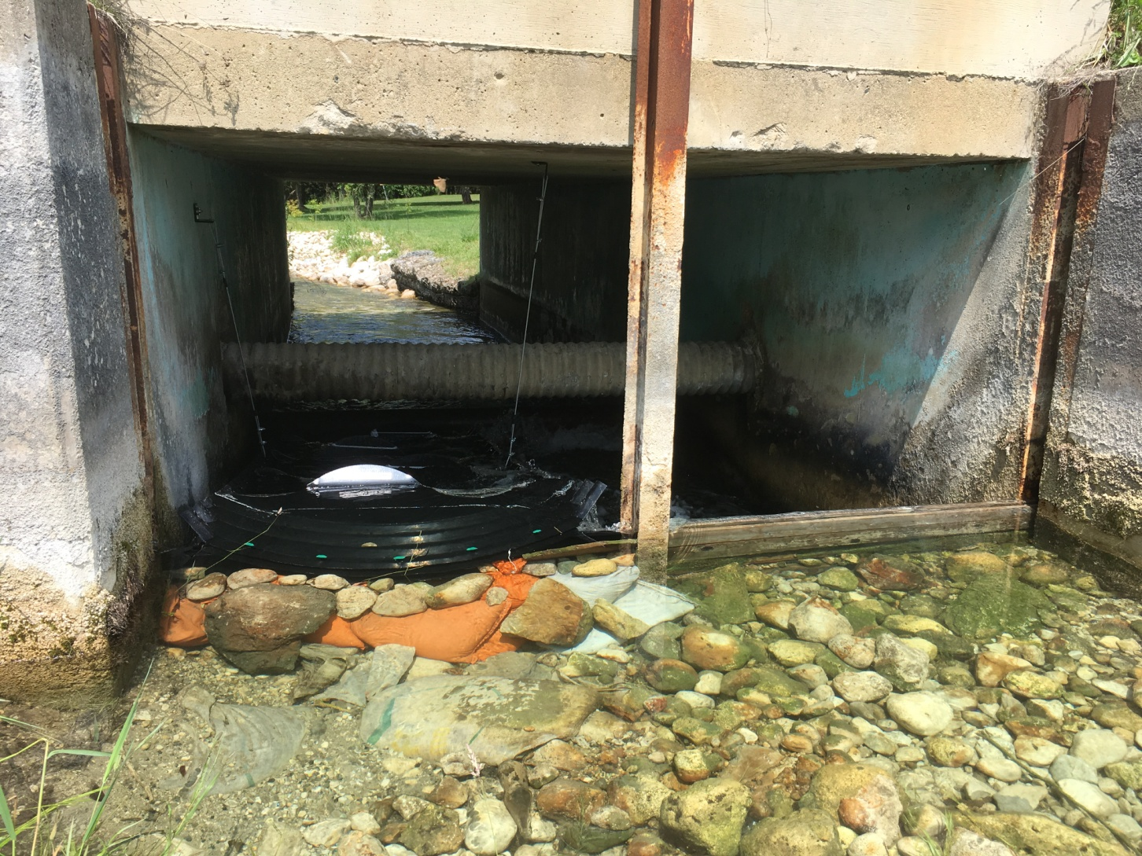
Crystal Clear and Cold

Slide 11
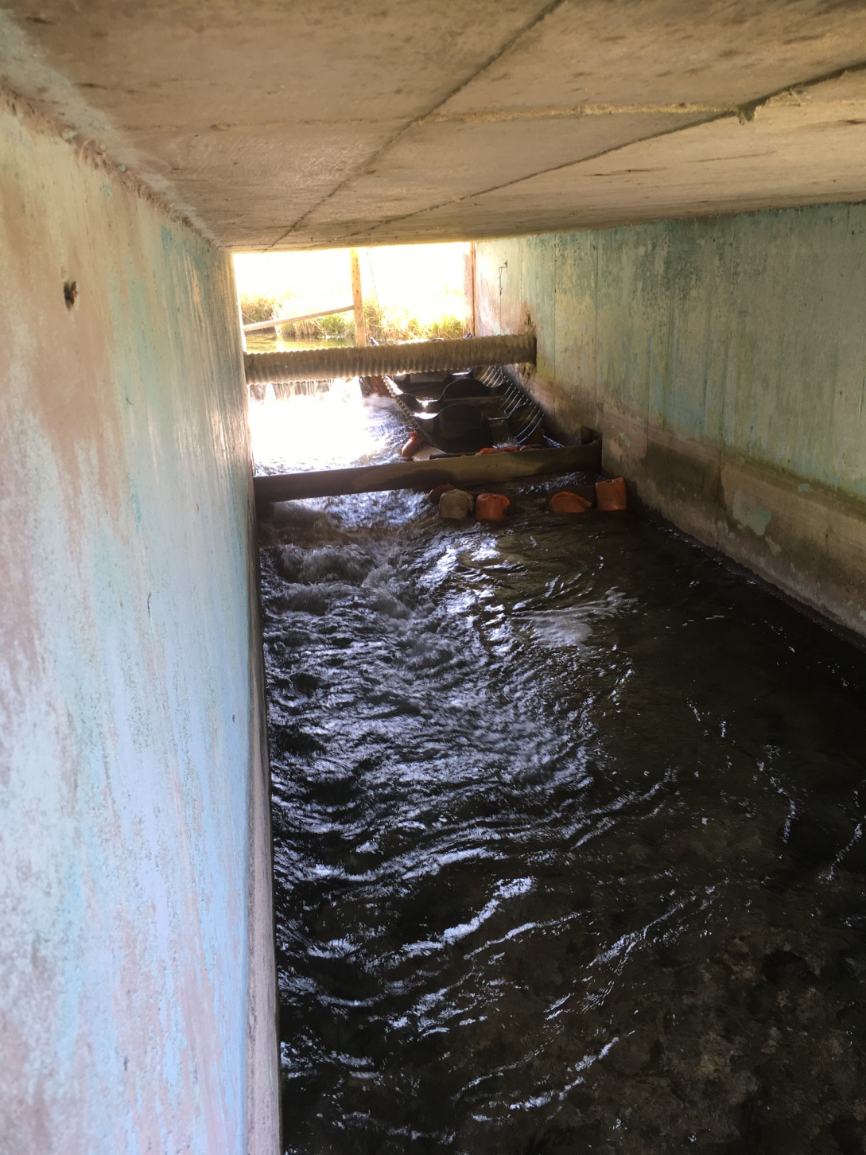
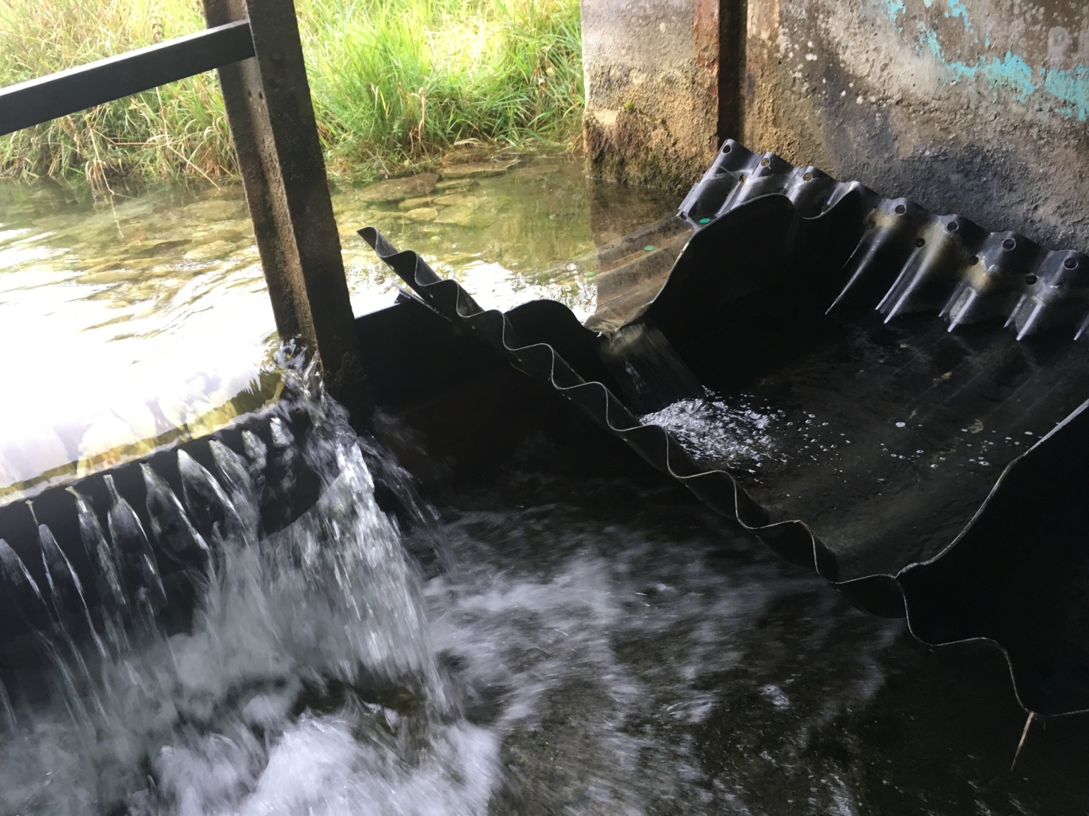
Over the Dam

Slide 12
South Grey News
Thank You
At South Grey News, we endeavour to bring you truthful up-to-date local community news in a quick and easy-to-digest format that’s free of political bias. We believe this service is more important today than ever before, as social media has given rise to misinformation, largely unchecked by big corporations who put profits ahead of their responsibilities.
South Grey News does not have the resources of a big corporation. We are a small, locally owned-and-operated organization. Research, analysis and physical attendance at public meetings and community events requires considerable effort. But contributions from readers and advertisers, however big or small, go a long way to helping us deliver positive, open and honest journalism for this community.
Please consider supporting South Grey News with a modest donation and let us know that our efforts are appreciated. Thank you.
Subscribe for FREE to get the latest local news delivered to your email box.

Slide 13
Thank You

